Slide 1
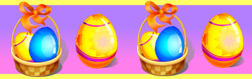
Pâques en France

Slide 2
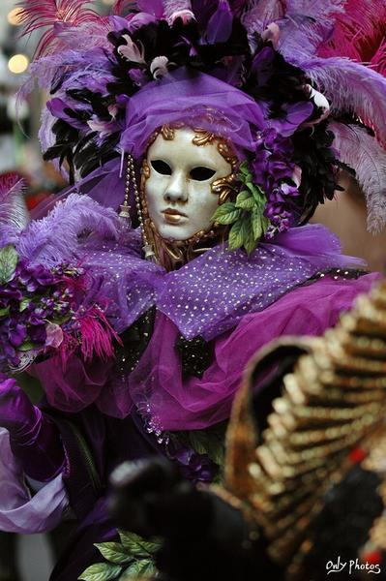
Le carnaval
Carnival is the festive season before Lent.
During carnival, there are parades and street parties. People dress up.
Carnival is a tradition mostly in Catholic societies, like France.

Slide 3
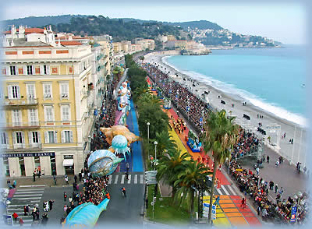
Le Carnaval de Nice
In the city of Nice, in the south of France, there is a very famous carnival every year.
In fact, it is the original Mardi Gras carnival and the oldest in the world!

Slide 4
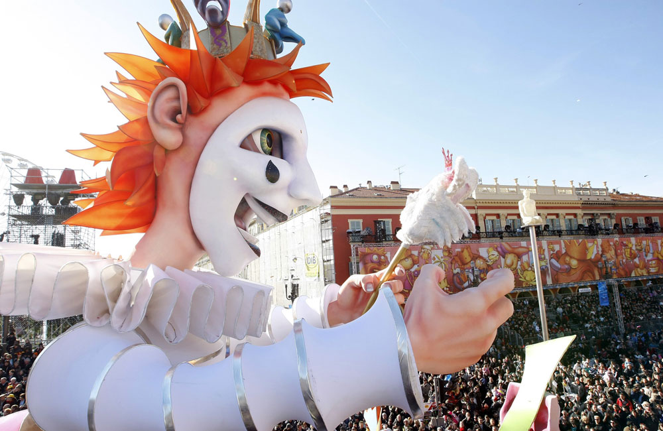
Le Carnaval de Nice
During the two weeks before Mardi Gras (Shrove), there are street parties, parades, shows, concerts, fireworks ..
People wear fancy-dress.

Slide 5

Le Carnaval de Nice
Each year, the Nice carnival has a theme.
This year the theme is “sport”
The event attracts around 1.2 million visitors.

Slide 6
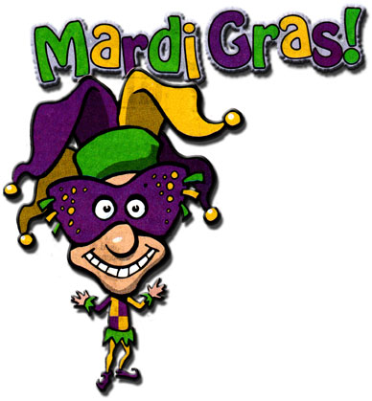
Mardi Gras
The carnival period finishes with Mardi Gras. It actually means ‘Fat Tuesday' and it is known as Shrove Tuesday in English.
It is the last day when you can eat everything you like before the fasting period of Lent.

Slide 7
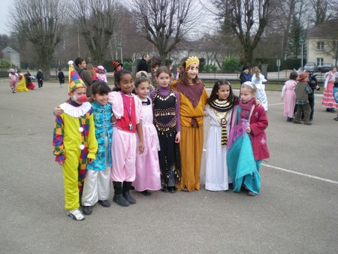
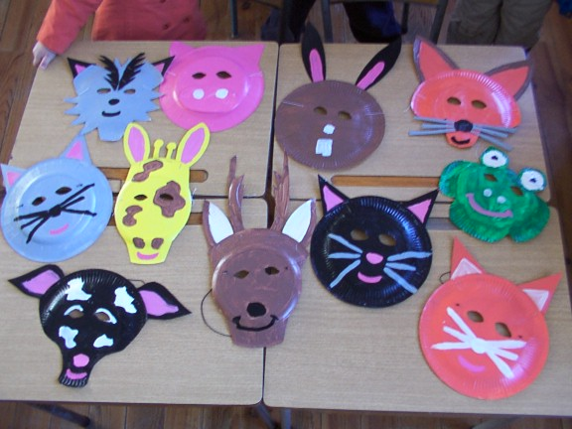
Mardi Gras
Children often celebrate Carnaval and Mardi Gras together.
They can dress up to go to school or wear a mask.

Slide 8
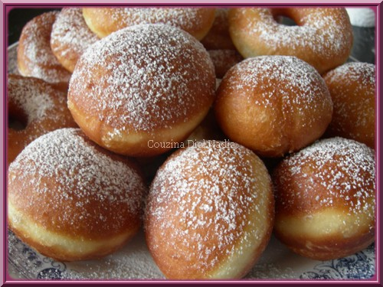
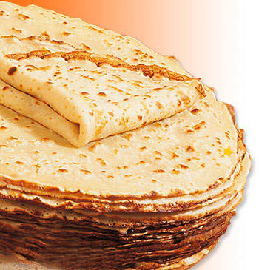
Mardi Gras
On Mardi Gras, French people traditionally eat doughnuts (les beignets) or pancakes (les crêpes).
These are the traditional food of Mardi Gras because they are a good way to use up all the extra flour, eggs and butter that should not be eaten during Lent.

Slide 9
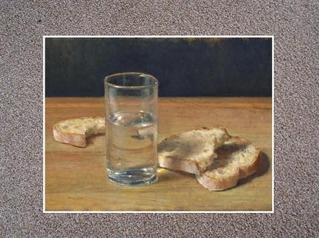
Le Carême
Lent is called le Carême which is another way of saying “forty days”.
The forty days represent the time that Jesus spent in the desert, where he endured temptation by Satan.

Slide 10
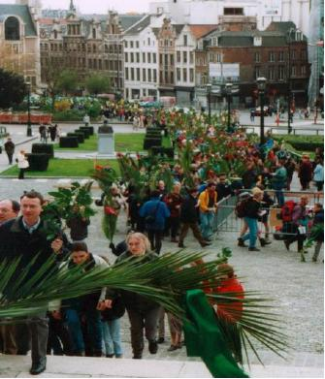
Le dimanche des Rameaux
Palm Sunday (le dimanche des Rameaux) is the Sunday before Easter and it marks the beginning of the Holy Week.
Palm leaves (often tied into crosses) are given in churches.

Slide 11

Les cloches
On the evening of Easter Thursday (le Jeudi Saint), all the church bells in France fly away to Rome!
They visit the Pope (le Pape) in the Vatican to be involved in remembering
the death of Jesus and to
be blessed by the pope.
So, all the church bells in
France remain silent until
the morning of Easter Sunday!

Slide 12
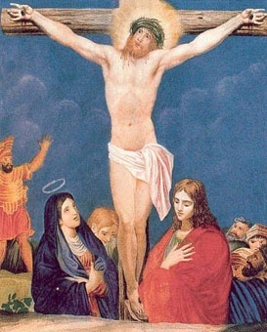
Vendredi Saint
Good Friday (vendredi saint) commemorates the crucifixion of Jesus Christ and his death.

Slide 13
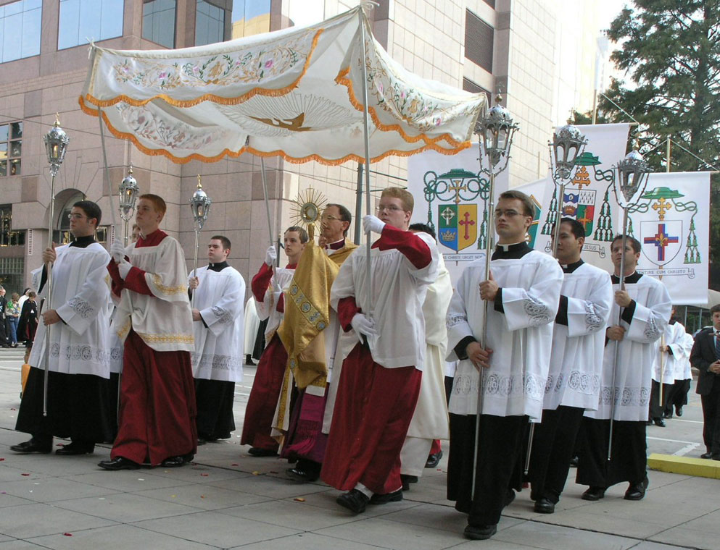
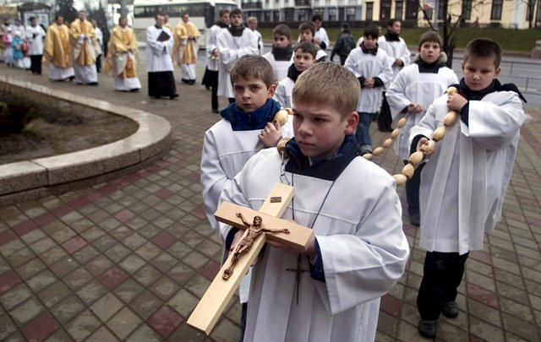
Les processions
There are lots of processions and religious parades in towns.

Slide 14
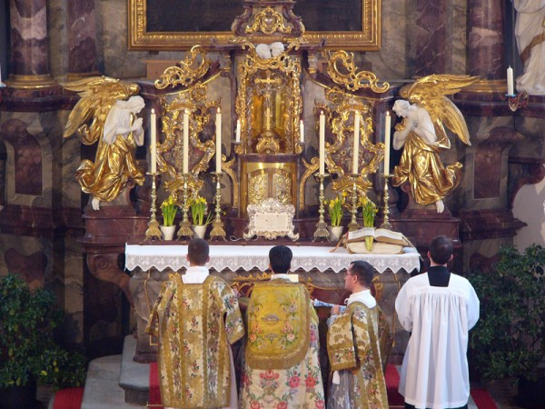
Le dimanche de Pâques
Christians believe that Jesus was resurrected from the dead three days after his crucifixion.
This resurrection is celebrated on Easter Sunday (dimanche de Pâques).

Slide 15
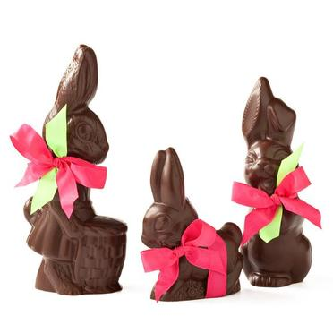
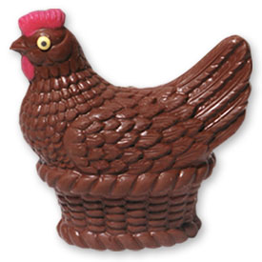
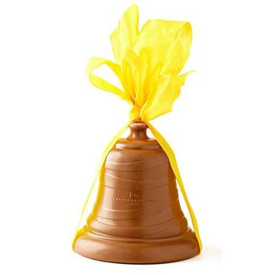
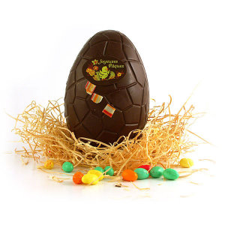
Le dimanche de Pâques
Early on the morning of Easter Sunday , the Easter bells (les cloches de Pâques) fly back to France!
They drop chocolate eggs, chicks, bells and bunnies in the gardens of the French towns.

Slide 16
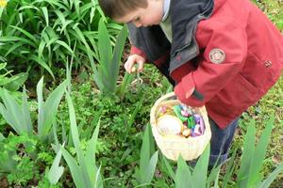
La chasse aux œufs
In the morning, the children awake very excited because it is time to search for the chocolate egg hunt (la chasse aux œufs).
And all the bells ring again because they are celebrating the resurrection of Jesus!

Slide 17
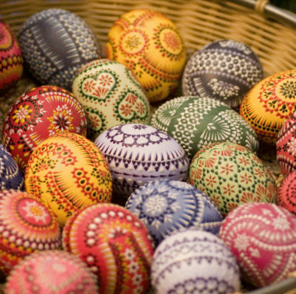
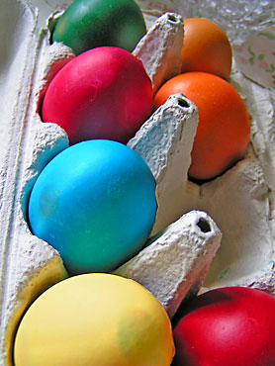
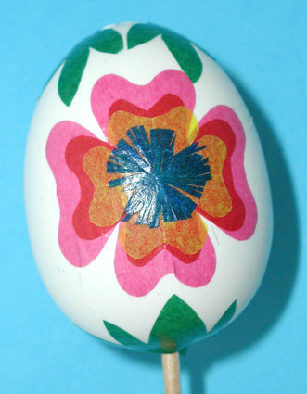
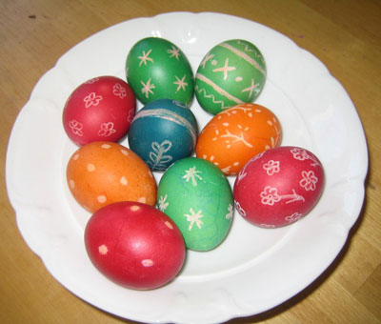
Les œufs de Pâques
The tradition of the Easter eggs dates back from the 4th century.
The eggs which were not eaten during Lent used to be decorated and then offered for Easter.

Slide 18
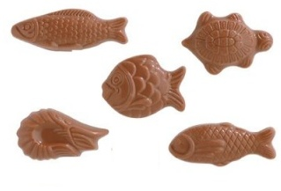
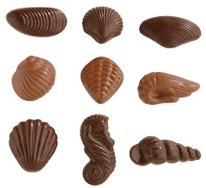
Les chocolats
In France, April fish are also an Easter symbol and that is why you will find chocolate fish in the shops too!
You can buy chocolates goodies in sweet shops (les confiseries) or in shops specialising in chocolate (les chocolateries).

Slide 19
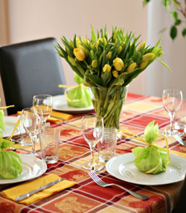
Le repas
There is generally an enormous amount of delicious food to eat.
French people spend a lot of the day eating with the whole family altogether.

Slide 20
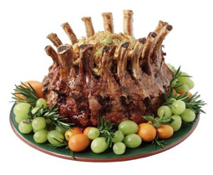
Le repas
People traditionally eat roast lamb (l'agneau).
There are lots of vegetables, for example, potatoes (les pommes de terre).

Slide 21
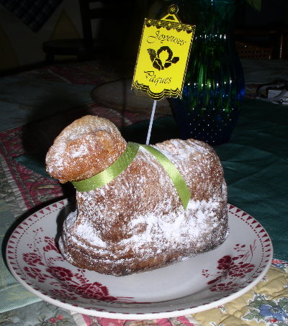
Le repas
In the Alsace region, the traditional dessert is a biscuit in the shape of the Easter lamb (l’agneau pascal or Osterlamala).

Slide 22
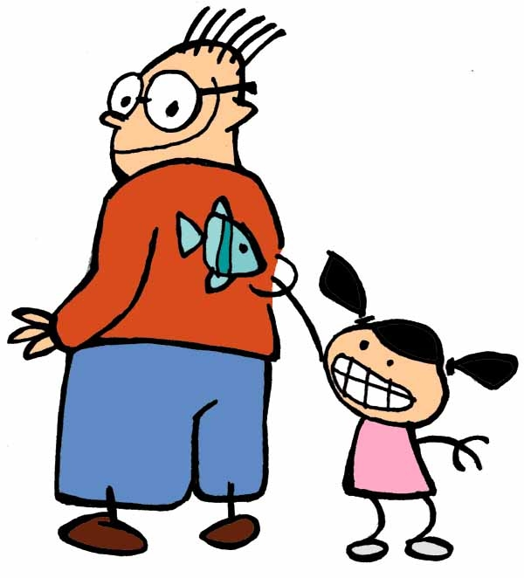
Poisson d’avril
Another important date is April Fools’ Day, on the 1st of April.
The tradition is that children play a trick on adults (parents, teachers…) by sticking paper fish onto their back.
Every time they manage to trick a grown-up, they run away shouting out “Poisson d'avril!” - and laughing lots too.

Slide 23

Poisson d’avril
Adults also like to tell jokes (les blagues) or play tricks on their friends or colleagues.
The media (tv, radio, newspapers) often report false but credible information to trick people.

Slide 24
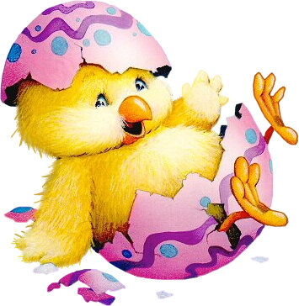
Quiz

Slide 25
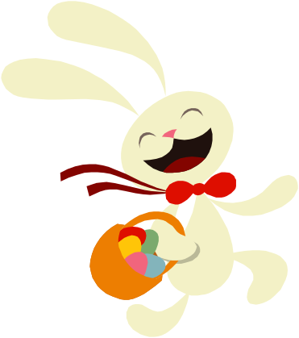
1. The French for “Shrove Tuesday” is…
Mardi Gras
Carnaval
Mardi des crêpes

Slide 26
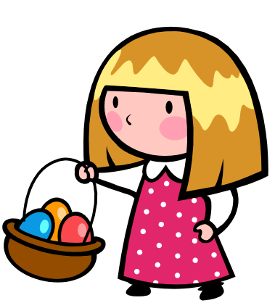
2. What happens in France on Shrove Tuesday?
There is no school
People eat a special type of bread
Children wear fancy dress

Slide 27
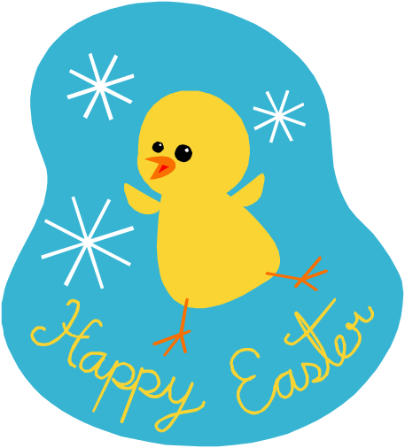
3. “Palm Sunday” is...
le dimanche des Rameaux
le dimanche de Pâques
le dimanche du chocolat

Slide 28
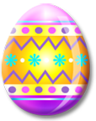
4. The word for “Easter” is...
Paquet
Pâques
Papillon

Slide 29
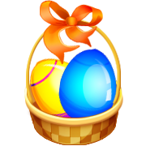
5. Easter is in the season of...
printemps
été
hiver

Slide 30
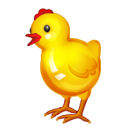
6. What is un œuf de Pâques?
an Easter card
an Easter bunny
an Easter egg

Slide 31
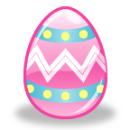
7. What is les cloches de Pâques?
the Easter parade
the Easter bells
the Easter dinner

Slide 32
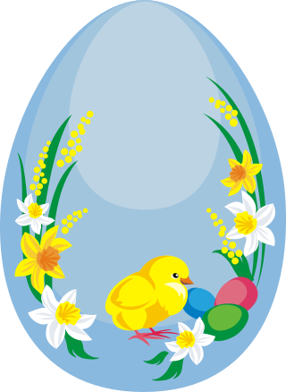
8. According to the French tradition, where do all the church bells fly to, at Easter?
Madrid
Paris
Rome

Slide 33
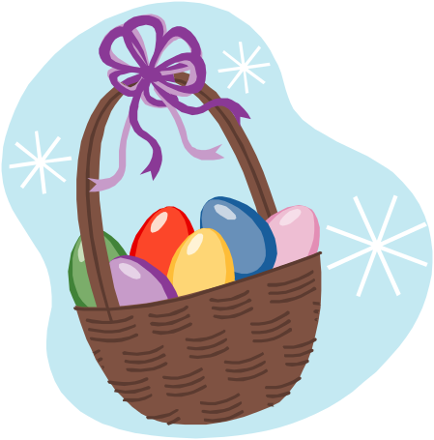
9. “The flying church bells” are called...
les cerfs-volants
les cloches volantes
les oiseaux volants

Slide 34
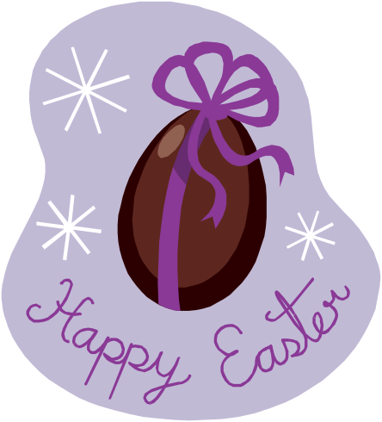
10. An “egg hunt” is ...
une chasse aux œufs
un panier d’œufs
une coquille d’œufs

Slide 35
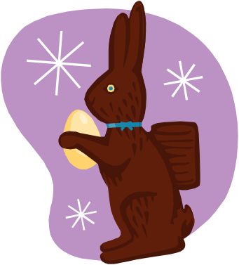
11. What is the word for
“a bunny”?
une poule
une cloche
un lapin

Slide 36
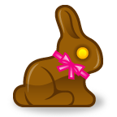
12. What is un panier d'œufs?
a box of eggs
a basket of eggs
a sack of eggs

Slide 37

13. Where would you buy Easter eggs?
la charcuterie
la gare
la confiserie

Slide 38
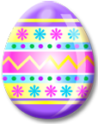
14. The traditional meat for Easter Sunday is lamb. The word for “lamb” is...
agneau
anneau
année

Slide 39
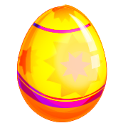
15. An April fool's trick is called...
un lapin d’avril
un mouton d’avril
un poisson d’avril

Slide 40
Solution
a
c
a
b
a
c
b
c
9. B
10. A
11. C
12. B
13. C
14. A
15. C

Slide 41
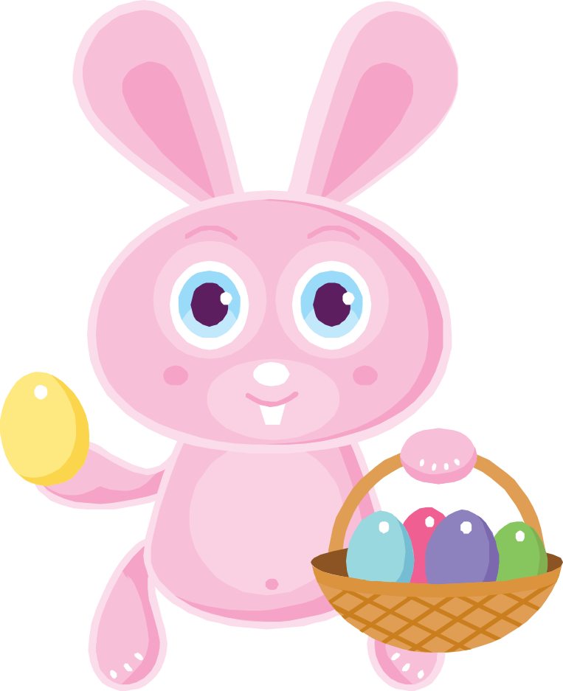
Joyeuses Pâques !

Slide 42
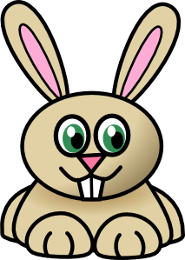
le lapin

Slide 43
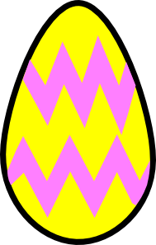
l’oeuf

Slide 44

la cloche

Slide 45
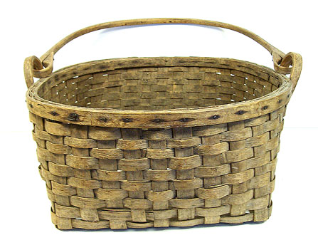
le panier

Slide 46
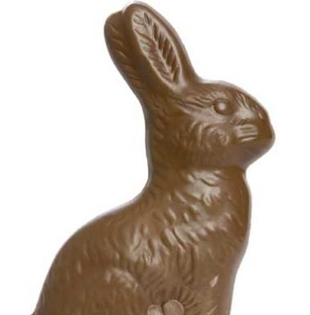

le chocolat

Slide 47

le ruban

Slide 48

le poussin

Slide 49

le nid

Slide 50

l’agneau

Slide 51
en français – en anglais? match up
l’agneau
le nid
le poussin
le ruban
le chocolat
le panier
la cloche
le lapin
pâques
bell
chocolate
ribbon
Easter bunny
lamb
chick
nest
Easter
basket

Slide 52
en français – en anglais? match up
l’agneau
le nid
le poussin
le ruban
le chocolat
le panier
la cloche
le lapin
pâques
lamb
nest
chick
ribbon
chocolate
basket
bell
Easter bunny
Easter

